Slide 1

TEAM MEMBERS
PREDICTING CREDIT CARD DEFAULT
SIMRAN MANSHARAMANI
IKYA NALLAPUNENI
UJJWOL PAUDEL
SHUBHAM BARBHAI
MITSU KANSAGARA
ROHIT KADHANE
BESTCARD
EXPERIENCE THE FREEDOM OF SPENDING WITH US
GROUP D2

Slide 2

CONTENT
PROBLEM STATEMENT
DATA EXPLORATION
DATA CLEANING
MODEL BUILDING
MODEL COMPARISON
PLAN TO EXECUTE DEPLOYMENT
CONCLUSION / FUTURE SCOPE
ADDITIONAL KNIME

Slide 3



PROBLEM
STATEMENT
The objective of this project is to develop a predictive model that can accurately predict whether a credit card customer is likely to default on their payment in the next month or not.
Better Decision Making
SOLUTION
Higher Profits
A model that provides insights to help identify high-risk customers and minimize the risk of default and potential losses
Low Risk Level

Slide 4
DATA EXPLORATION
# Rows = 26664
# Columns = 31
- No Missing Data
Features & data type:
Age (int)
Education (int)
Marriage (int)
Bill amounts (int)
Education_Cat (object)

Slide 5
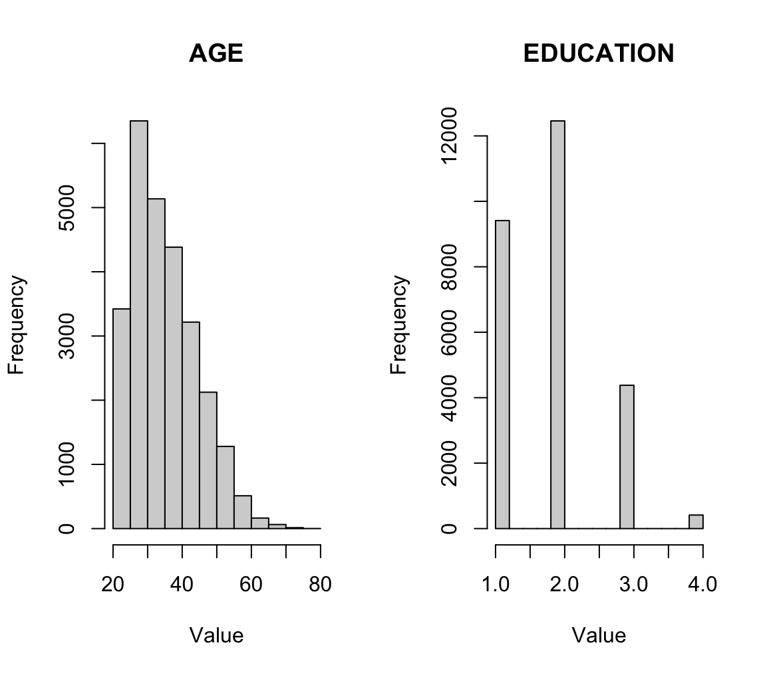
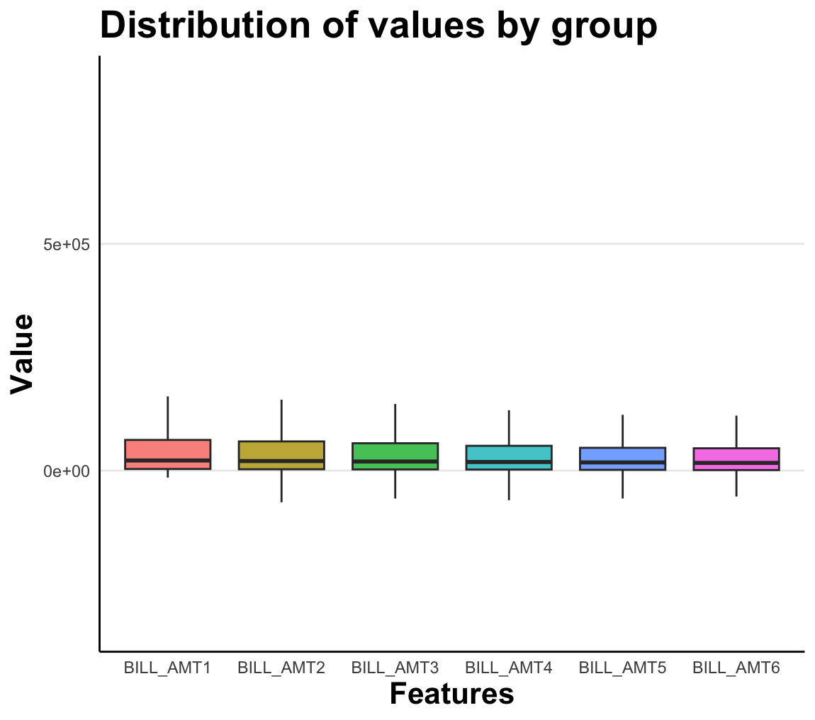
DATA EXPLORATION
Frequency distribution for defaulters
0 | 20750
1 | 5914

Slide 6
DATA CLEANING
Drop ‘EDUCATION_CAT’ and ‘ID’ column
Normalization using Min Max Scaler
Drop ‘default payment next month’ to define features and target variables

Slide 7
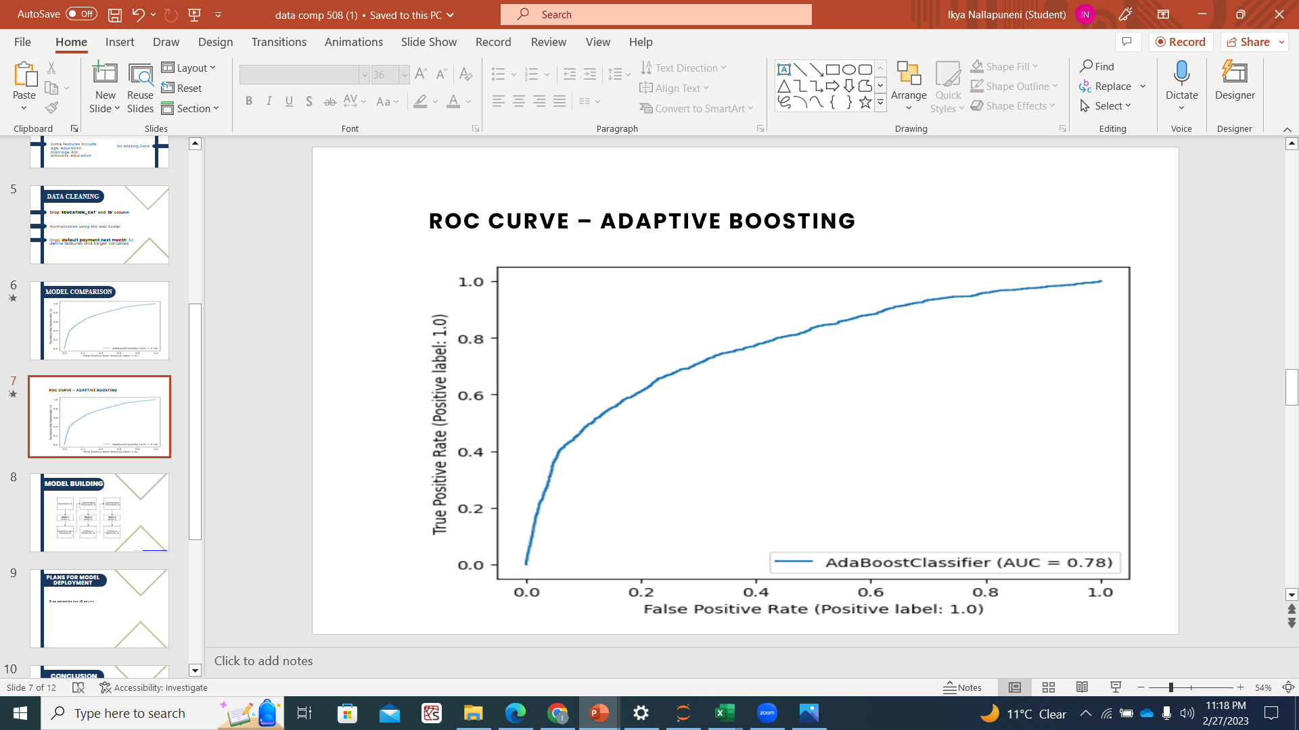
MODEL COMPARISON
R
E
C
O
M
M E
N
D
A
T
I
O
N
S.No | MODEL | ACCURACY
1. | Adaptive Boosting | 0.829
2. | Gradient Boosting | 0.820
3. | Decision Tree | 0.8196
4. | SVM | 0.8190
5. | Logistic Regression | 0.810
6. | KNN | 0.808
7. | Extra Tree classifier | 0.719
8. | Gaussian NB | 0.501

Slide 8
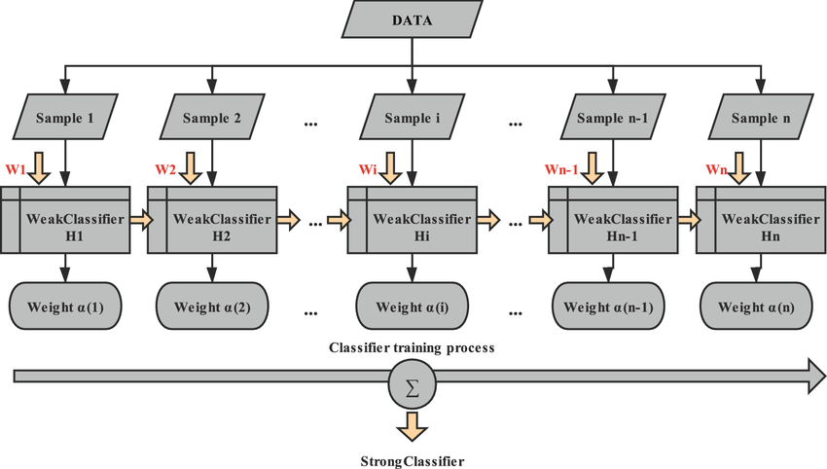
MODEL BUILDING
Reference (Image from): https://www.researchgate.net/figure/The-flowchart-of-the-Adaboost-algorithm_fig3_352781421

Slide 9
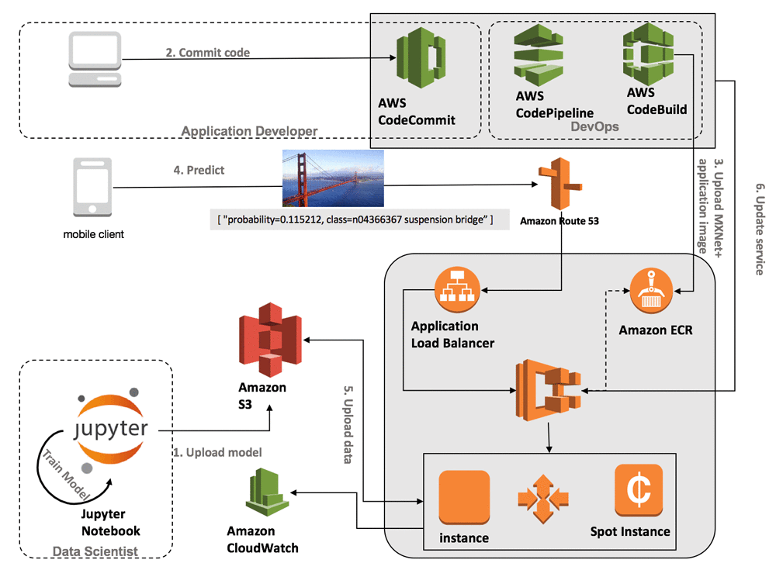
PLANS FOR MODEL DEPLOYMENT
Model Deployment - “AWS”
How to execute Model Deployment?
Step 1: Create an Amazon S3 bucket
Step 2: Create an Amazon EC2 instance
Step 3: Install any dependencies Step 4: Copy your model to the EC2 instance
Step 5: Run the model

Slide 10
VALUE
Reduced follow-up costs
Deciding threshold on credit limit and loans
Significantly more profits

Slide 11
CONCLUSION / FUTURE SCOPE
We have chosen the AdaBoost algorithm considering its accuracy. Since the model learns from its previous misclassified data, it will not be difficult to add more data.
Further work includes deploying the model and evaluating its performance based on incoming data.
We can next work on how much limit the company has for credits or should have loans as per different groupings.

Slide 12
THANK YOU

Slide 13
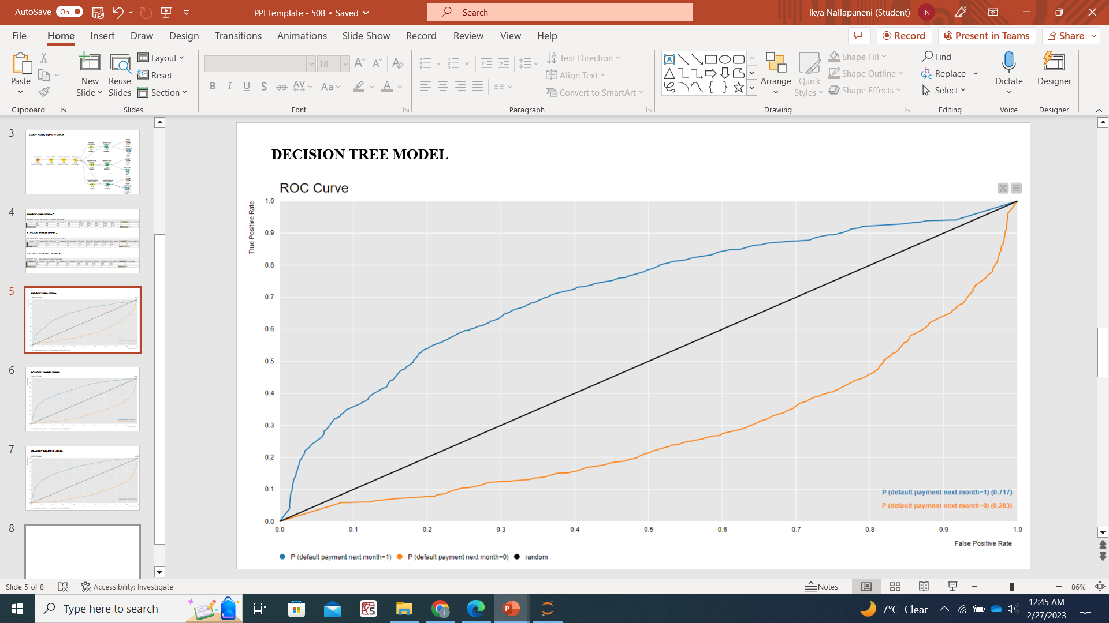
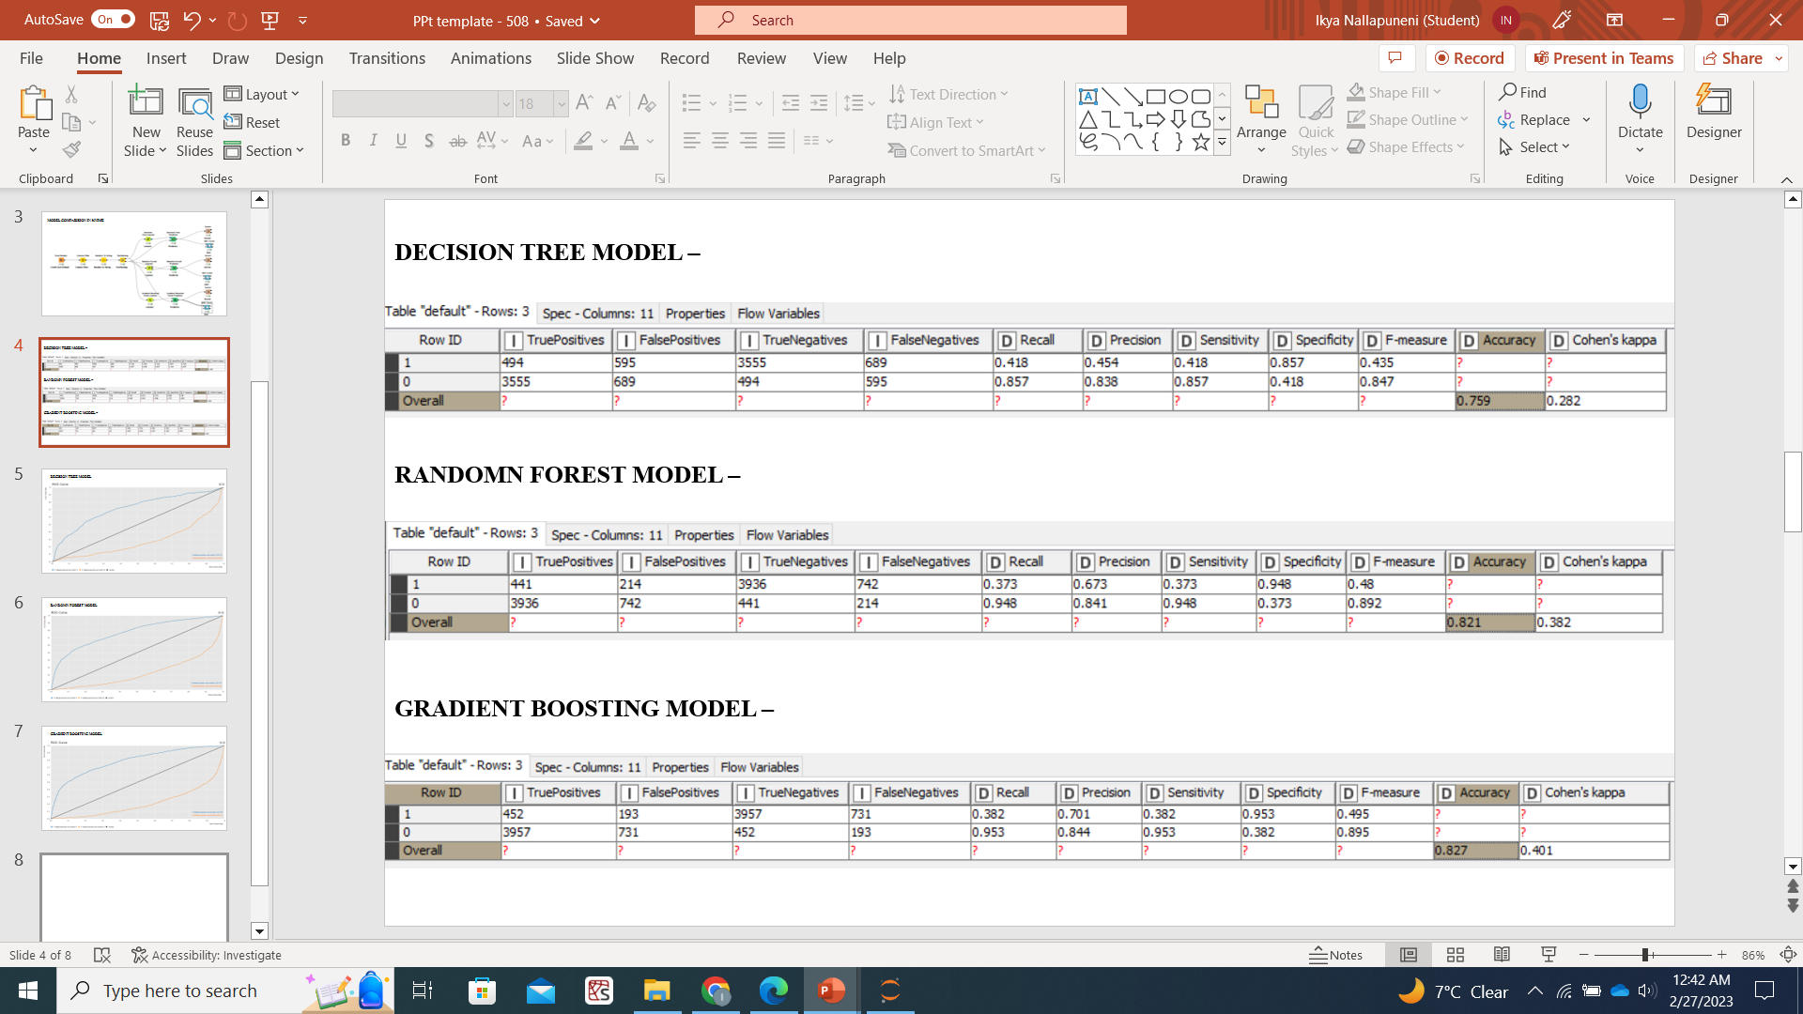

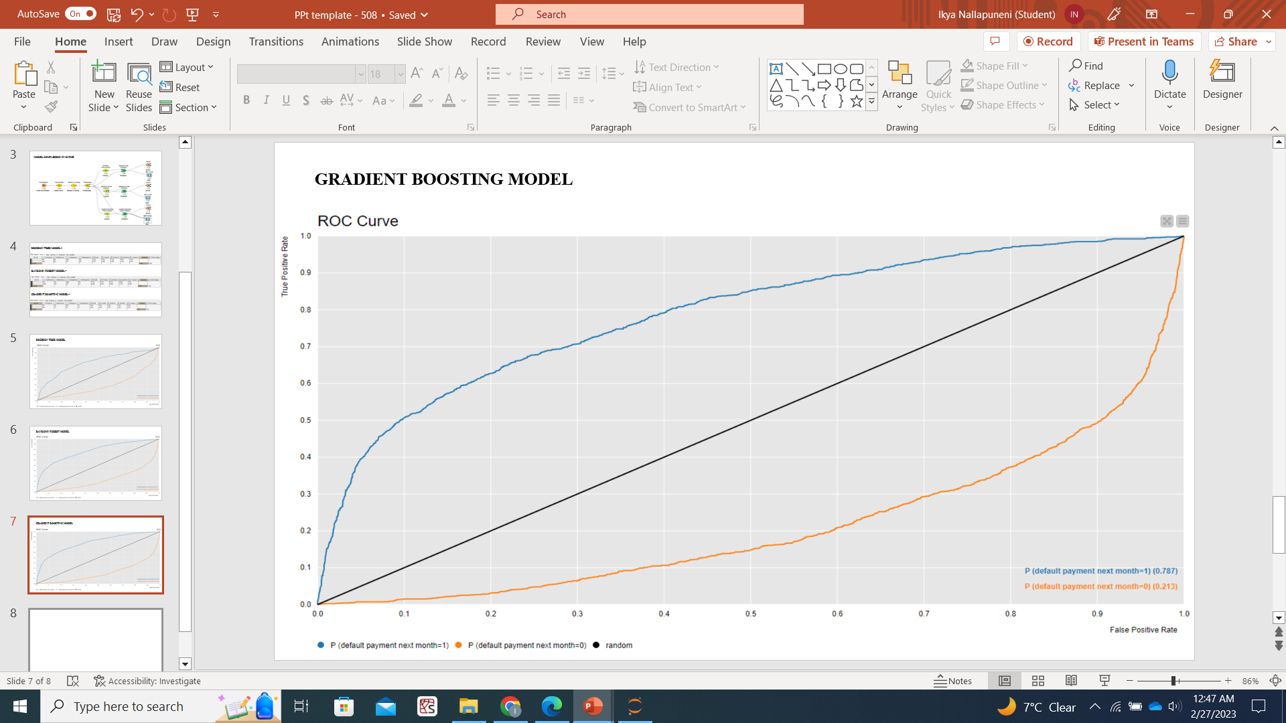
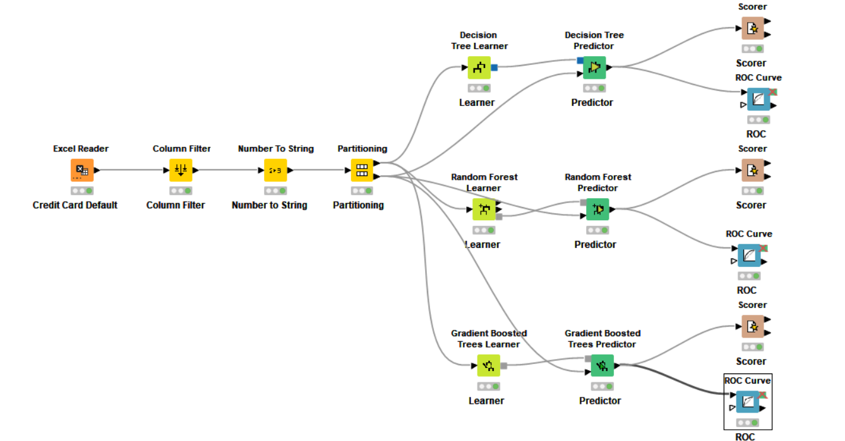
ADDITIONAL - KNIME
Model Comparison

